Slide 1
Discrete Structures
CH 01: Logic and Proofs

Slide 2
QUIZ
What is a proposition?
What is a conjunction, disjunction?
What is a conditional statement?
What is a tautology, contradiction, logical equivalence?
What are quantifiers?
What are Google search operators?

Slide 3
Content
The Foundations: Logic and Proofs
Propositional Logic
Applications of Propositional Logic
Propositional Equivalences
Predicates and Quantifiers
Nested Quantifiers
Rules of Inference
Introduction to Proofs
Proof Methods and Strategy

Slide 4

Nested Quantifiers
Nested quantifiers, where one quantifier is within the scope of another, such as $∀x∃y\left(x + y = 0\right)$ is the same thing as $∀xQ(x)$, where $Q(x)$ is $∃yP(x, y)$, where $P(x, y)$ is $x + y = 0$.

Slide 5

Nested Quantifiers
EXAMPLE 1: Assume that the domain for the variables $x$ and $y$ consists of all real numbers. The statement $∀x∀y(x + y = y + x)$ says that $x + y = y + x$ for all real numbers $x$ and $y$ (commutative law for addition of real numbers.)
The statement $∀x∃y(x + y = 0)$ says that for every real number $x$ there is a real number $y$ such that $x + y = 0$ (every real number has an additive inverse.)

Slide 6

Nested Quantifiers
EXAMPLE 2: Translate into English the statement $∀x∀y\left(\left(x > 0\right)∧ \left(y < 0\right)→ \left(xy < 0\right)\right)$ where the domain for both variables consists of all real numbers.
Solution: “The product of a positive real number and a negative real number is always a negative real number.”

Slide 7

Nested Quantifiers
THINKING OF QUANTIFICATION AS LOOPS:
$∀x∀yP(x, y)$
$∀x∃yP(x, y)$
$∃x∀yP(x, y)$
$∃x∃yP(x, y)$

Slide 8



Nested Quantifiers
THINKING OF QUANTIFICATION AS LOOPS:
$∀x∀yP(x, y)$
$∀x∃yP(x, y)$
$∃x∀yP(x, y)$
$∃x∃yP(x, y)$
$$x_{1} \\ x_{2}$$
.
.
.
$$x_{n}$$
$$y_{1} \\ y_{2}$$
.
.
.
$$y_{n}$$
For every $x$and for every $y$, $p(x,y)$ is true

Slide 9


Nested Quantifiers
THINKING OF QUANTIFICATION AS LOOPS:
$∀x∀yP(x, y)$
$∀x∃yP(x, y)$
$∃x∀yP(x, y)$
$∃x∃yP(x, y)$
$$x_{1} \\ x_{2}$$
.
.
.
$$x_{n}$$
For every $x$and for a $y$, $p(x,y)$ is true
$$y_{1}$$

Slide 10


Nested Quantifiers
THINKING OF QUANTIFICATION AS LOOPS:
$∀x∀yP(x, y)$
$∀x∃yP(x, y)$
$∃x∀yP(x, y)$
$∃x∃yP(x, y)$
$$y_{1} \\ y_{2}$$
.
.
.
$$y_{n}$$
For an $x$and for every $y$, $p(x,y)$ is true
$$x_{1}$$

Slide 11



Nested Quantifiers
THINKING OF QUANTIFICATION AS LOOPS:
$∀x∀yP(x, y)$
$∀x∃yP(x, y)$
$∃x∀yP(x, y)$
$∃x∃yP(x, y)$
For an $x$and an $y$, $p(x,y)$ is true
$$x_{1}$$
$$y_{1}$$

Slide 12
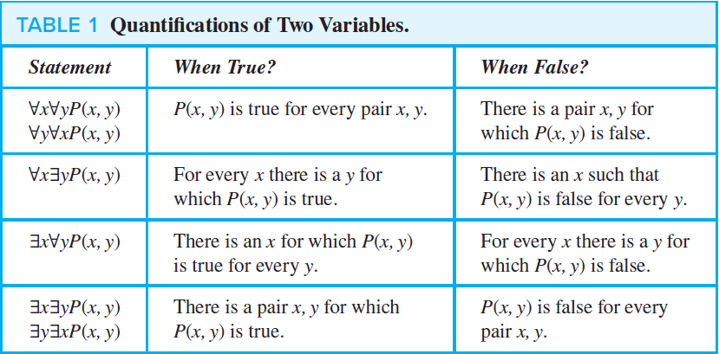
Nested Quantifiers
THINKING OF QUANTIFICATION AS LOOPS:
$∀x∀yP(x, y)$
$∀x∃yP(x, y)$
$∃x∀yP(x, y)$
$∃x∃yP(x, y)$

Slide 13
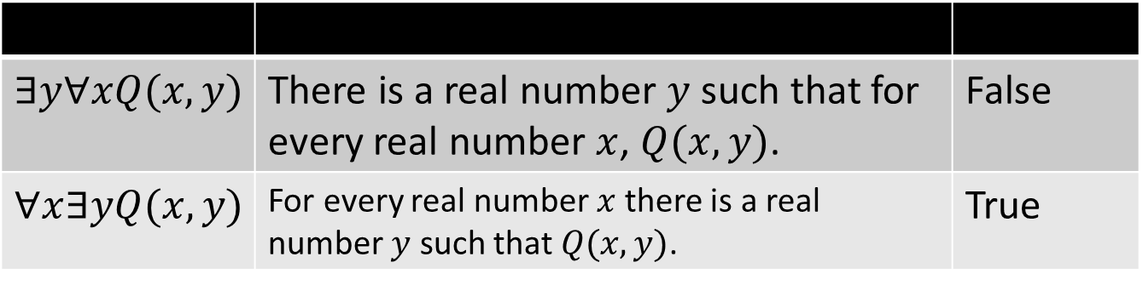

Nested Quantifiers
EXAMPLE 4: Let $Q(x, y)$ denote $“x + y = 0.”$ What are the truth values of the quantifications $∃y∀xQ(x, y)$ and $∀x∃yQ(x, y)$, where the domain for all variables consists of all real numbers?
Solution: $x + y = 0$
$$∃y∀xQ(x, y)$$ | There is a real number $y$ such that for every real number $x$, $Q(x, y)$. | False
$$∀x∃yQ(x, y)$$ | For every real number $x$ there is a real number $y$ such that $Q(x, y)$. | True

Slide 14

Nested Quantifiers
EXAMPLE 6: Translate the statement $“The sum of two positive integers is always positive”$ into a logical expression.
Solution: $∀x∀y\left(\left(x > 0\right)∧ \left(y > 0\right)→ \left(x + y > 0\right)\right),$ or $∀x∀y(x + y > 0),$ where the domain for both variables consists of all positive integers

Slide 15

Nested Quantifiers
EXAMPLE 9: Translate the statement $∀x\left(C\left(x\right)∨ ∃y\left(C\left(y\right)∧ F\left(x, y\right)\right)\right)$ into English, where $C(x)$ is $“x has a computer,”$ $F(x, y)$ is $“x and y are friends,”$ and the domain for both $x$ and $y$ consists of all students in your school.
Solution: The statement says that for every student $x$ in your school, $x$ has a computer or there is a student $y$ such that $y$ has a computer and $x$ and $y$ are friends. In other words, every student in your school has a computer or has a friend who has a computer.

Slide 16

Nested Quantifiers
EXAMPLE 11: Express the statement $“If a person is female and is a parent, then this person is someone’s$ $mother”$ as a logical expression involving predicates, quantifiers with a domain consisting of all people, and logical connectives.
Solution: $∀x((F(x) ∧ P(x)) → ∃yM(x, y)).$
or $$∀x∃y((F(x) ∧ P(x)) → M(x, y)).$$

Slide 17

Nested Quantifiers
EXAMPLE 14: Express the negation of the statement $∀x∃y(xy = 1)$ so that no negation precedes a quantifier.
Solution: $∃x∀y(xy ≠ 1).$

Slide 18

Exercises
Translate these statements into English, where the domain for each variable consists of all real numbers. a)$∀x∃y(x < y)$
b)$∀x∀y(((x ≥ 0) ∧ (y ≥ 0)) → (xy ≥ 0))$
c)$∀x∀y∃z(xy = z)$

Slide 19

Exercises
Translate these statements into English, where the domain for each variable consists of all real numbers. a)$∀x∃y(x < y)$
b)$∀x∀y(((x ≥ 0) ∧ (y ≥ 0)) → (xy ≥ 0))$
c)$∀x∀y∃z(xy = z)$
For every real number $x$ there exists a real number $y$ such that $x$ is less than $y$.
For every real number $x$ and real number $y$, if $x$ and $y$ are both nonnegative, then their product is nonnegative.
For every real number $x$ and real number $y$, there exists a real number $z$ such that the product of $x$ and $y$ is equal to $z$

Slide 20
Exercises
14. Use quantifiers and predicates with more than one variable to express these statements.
b) Every student in this class plays some sport.

Slide 21

Exercises
14. Use quantifiers and predicates with more than one variable to express these statements.
b) Every student in this class plays some sport.
b) Let $P(x, y)$ mean that person $x$ plays sport $y$. Then our statement is $∀x∃y$ $P(x, y)$ .

Slide 22
Exercises
15. Use quantifiers and predicates with more than one variable to express these statements.
a) Every computer science student needs a course in discrete mathematics.
c) Every student in this class has taken at least one computer science course.

Slide 23

Exercises
15. Use quantifiers and predicates with more than one variable to express these statements.
a) Every computer science student needs a course in discrete mathematics.
c) Every student in this class has taken at least one computer science course.
a) $∀xP(x)$, where $P(x)$ is $“x needs a course in discrete mathematics”$ and the domain consists of all computer science students
c) $∀x∃yP(x, y)$, where $P(x, y)$is $“x has taken y,”$the domain for $x$ consists of all students in this class, and the domain for $y$ consists of all computer science classes

Slide 24
Exercises
19. Express each of these statements using mathematical and logical operators, predicates, and quantifiers, where the domain consists of all integers.
b) The difference of two positive integers is not necessarily positive.
d) The absolute value of the product of two integers is the product of their absolute values.

Slide 25

Exercises
19. Express each of these statements using mathematical and logical operators, predicates, and quantifiers, where the domain consists of all integers.
b) The difference of two positive integers is not necessarily positive.
d) The absolute value of the product of two integers is the product of their absolute values.
b) $¬∀x∀y ((x > 0) ∧ (y > 0) → (x − y > 0))$
d) $∀x∀y (|xy| = |x||y|)$

Slide 26

Exercises
24. Translate each of these nested quantifications into an English statement that expresses a mathematical fact. The domain in each case consists of all real numbers.
a) $∃x∀y(x + y = y)$

Slide 27

Exercises
24. Translate each of these nested quantifications into an English statement that expresses a mathematical fact. The domain in each case consists of all real numbers.
a) $∃x∀y(x + y = y)$
a) There is a real-number $x$, that is added to any real number $y$, does not change the value of $y$. (Addition identity ــ 0)

Slide 28

Exercises
26. Let $Q(x, y)$ be the statement “$x + y = x − y.$” If the domain for both variables consists of all integers, what are the truth values?
a) $Q(1, 1)$ d) $∃xQ(x, 2)$ e) $∃x∃yQ(x, y)$ i) $∀x∀yQ(x, y)$ h) $∀y∃xQ(x, y)$

Slide 29

Exercises
26. Let $Q(x, y)$ be the statement “$x + y = x − y.$” If the domain for both variables consists of all integers, what are the truth values?
a) $Q(1, 1)$ d) $∃xQ(x, 2)$ e) $∃x∃yQ(x, y)$ i) $∀x∀yQ(x, y)$ h) $∀y∃xQ(x, y)$
a) This is false, since $1 + 1≠ 1 − 1$.
d) This is false, since the equation $x + 2 = x −2$ has no solution.
e) This is true, since we can take $x = y = 0$.
i) False
h) False

Slide 30

Exercises
28. Determine the truth value of each of these statementsif the domain of each variable consists of all real numbers.
a) $∀x∃y(x^{2} = y)$

Slide 31


Exercises
28. Determine the truth value of each of these statements if the domain of each variable consists of all real numbers.
a) $∀x∃y(x^{2} = y)$
a) This is true, since for a given real $x$, $y=x^{2}$. For example, if $x=5$, then $y=5^{2}=25$

Slide 32

Exercises
29. Suppose the domain of the propositional function $P(x, y)$ consists of pairs $x$ and $y$, where x is $1, 2, or 3$ and $y$ is $1, 2, or 3$. Write out these propositions using disjunctions and conjunctions.
b) $∃x∃yP(x, y)$ d) $∀y∃xP(x, y)$

Slide 33


Exercises
29. Suppose the domain of the propositional function $P(x, y)$ consists of pairs $x$ and $y$, where x is $1, 2, or 3$ and $y$ is $1, 2, or 3$. Write out these propositions using disjunctions and conjunctions. b) $∃x∃yP(x, y)$ d) $∀y∃xP(x, y)$
b) $P\left(1, 1\right)∨ P\left(1, 2\right)∨ P\left(1, 3\right)∨ P\left(2, 1\right)∨ P\left(2, 2\right)∨ P\left(2, 3\right)∨ P\left(3,1\right)∨ P\left(3, 2\right)∨ P\left(3, 3\right)$
d) $(P(1, 1) ∨ P(2, 1) ∨ P(3, 1)) ∧ (P(1, 2) ∨ P(2, 2) ∨ P(3, 2)) ∧ (P(1, 3) ∨ P(2, 3) ∨ P(3, 3))$

Slide 34
Exercises
36. Express each of these statements using quantifiers. Then form the negation of the statement so that no negation is to the left of a quantifier. Next, express the negation in simple English. (Do not simply use the phrase “It is not the case that.”)
a) No one has lost more than one thousand dollars playing the lottery.

Slide 35

Exercises
36. Express each of these statements using quantifiers. Then form the negation of the statement so that no negation is to the left of a quantifier. Next, express the negation in simple English. (Do not simply use the phrase “It is not the case that.”)
a) No one has lost more than one thousand dollars playing the lottery.
a) Let $L(x, y)$mean that person $x$ has lost $y$ dollars playing the lottery. The original statement is then $¬∃x∃y(y > 1000 ^ L(x, y))$. Its negation is $∃x∃y(y > 1000 ^ L(x, y))$ ; someone has lost more than
$1000 playing the lottery.

Slide 36

Exercises
46. Determine the truth value of the statement $∃x∀y(x ≤ y^{2})$ if the domain for the variables consists of
a) the positive real numbers.
b) the integers.
c) the nonzero real numbers.

Slide 37

Exercises
46. Determine the truth value of the statement $∃x∀y(x ≤ y^{2})$ if the domain for the variables consists of
a) the positive real numbers.
b) the integers.
c) the nonzero real numbers.
False, try $x=1$ and $y=0.5$
True, try $x=−1$ and $y=any integer$
True, try $x=−1$ and $y=any real number$

Slide 38
TASK
SECTION 1.5
2 (a)
14 (a)
15 (b, d)
19 (a, c)
25 (a)
26 (b, c, f, g)
28 (b)
29 (a, c)
36 (b)

